Slide 1
AdaBoost Regressor
An Ensemble Technique for Regression Tasks

Slide 2
What is AdaBoost?
AdaBoost (Adaptive Boosting) is an ensemble method that combines multiple weak learners to create a strong regressor.
Each subsequent model focuses more on the errors made by previous models, improving accuracy over time.

Slide 3
How AdaBoost Works
1. Train a base regressor on the original data.
2. Evaluate errors and give more weight to mispredicted samples.
3. Train the next regressor focusing on these samples.
4. Repeat the process for n estimators.
5. Combine all models' predictions into a final prediction.

Slide 4
Key Parameters in AdaBoostRegressor
• estimator: The base regressor model (e.g., DecisionTreeRegressor).
• n_estimators: Number of boosting rounds.
• learning_rate: Shrinks the contribution of each model.
• random_state: Controls randomness for reproducibility.

Slide 5
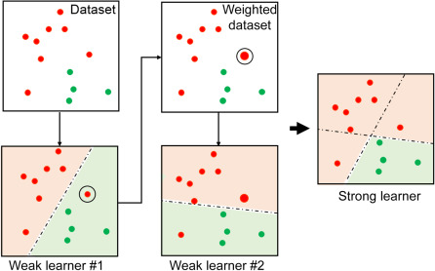
Representation of in AdaBoost

Slide 6
Advantages and Use Cases
✓ Reduces bias and variance
✓ Works well with noisy data
✓ Often outperforms single models
Used in: Regression tasks in finance, healthcare, sales forecasting, etc.

